Slide 1
Chapter 2: Object Oriented Programming

Slide 2
Learning Objectives
OOPs Introduction
Typing (Types) in C#
C# Arrays
C# Strings
C# Classes and Structs and Enums
Contracts and Interfaces in C#

Slide 3
OOP: Introduction
Object-oriented programming (OOP) refers to a type of computer programming (software design) in which programmers define not only the data type of a data structure, but also the types of operations (functions) that can be applied to the data structure.
C# provides full support for object-oriented programming including encapsulation, inheritance, and polymorphism.
Encapsulation means that a group of related properties, methods, and other members are treated as a single unit or object.
Inheritance describes the ability to create new classes based on an existing class.
Polymorphism means that you can have multiple classes that can be used interchangeably, even though each class implements the same properties or methods in different ways.

Slide 4
Object-Oriented Programming

Slide 5
C# – Types
C# is a strongly-typed language.
Every variable and constant has a type, as does every expression that evaluates to a value.
Every method signature specifies a type for each input parameter and for the return value.
The .NET Framework class library defines a set of built-in numeric types as well as more complex types that represent a wide variety of logical constructs, such as the file system, network connections, collections and arrays of objects, and dates.
The information stored in a type can include the following:
The storage space that a variable of the type requires.
The maximum and minimum values that it can represent.
The members (methods, fields, events, and so on) that it contains.
The base type it inherits from.
The location where the memory for variables will be allocated at run time.
The kinds of operations that are permitted.
You can create your own types by creating Structs, Interfaces, Classes and Enums.

Slide 6
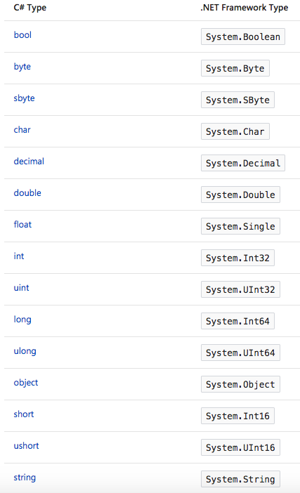
C# – Built-in Types
C# provides a standard set of built-in numeric types to represent integers, floating point values, Boolean expressions, text characters, decimal values, and other types of data.
There are also built-in string and object types.
These are available for you to use in any C# program.
The table on right lists down the built-in types available in C# and the corresponding .NET framework types.
.NET framework has CTS (Common Type System) that enables code written in one language to be compatible and be used by code in other languages; for e.g. you can use a library written in VB.NET in a C# program and vice-versa. All OOP concepts like Inheritance, Polymorphism, Encapsulation and Abstraction are supported by CTS.

Slide 7
.NET – CTS
It is important to understand two fundamental points about the type system in the .NET Framework:
It supports the principle of inheritance. Types can derive from other types, called base types. The derived type inherits (with some restrictions) the methods, properties, and other members of the base type. The base type can in turn derive from some other type, in which case the derived type inherits the members of both base types in its inheritance hierarchy. All types, including built-in numeric types such as Int32 (C# keyword: int), derive ultimately from a single base type, which is Object (C# keyword: object). This unified type hierarchy is called the Common Type System (CTS).
Each type in the CTS is defined as either a value type or a reference type. This includes all custom types in the .NET Framework class library and also your own user-defined types. Types that you define by using the struct keyword are value types; all the built-in numeric types are structs. Types that you define by using the class keyword are reference types. Reference types and value types have different compile-time rules, and different run-time behavior.

Slide 8
.NET CTS Relationships

Slide 9
.NET Value Types
Value types derive from ValueType, which derives from Object.
Types that derive from ValueType have special behaviour in the CLR.
Value type variables directly contain their values, which means that the memory is allocated inline in whatever context the variable is declared.
There is no separate heap allocation or garbage collection overhead for value-type variables.
There are two categories of value types:
struct
enum.
The built-in numeric types are structs, and they have properties and methods that you can access.
Value types are sealed, which means, for example, that you cannot derive a type from Int32, and you cannot define a struct to inherit from any user-defined class or struct because a struct can only inherit from ValueType.
However, a struct can implement one or more interfaces. You can cast a struct type to an interface type; this causes a boxing operation to wrap the struct inside a reference type object on the managed heap.
Boxing operations occur when you pass a value type to a method that takes a Object as an input parameter.
The other category of value types is enum. An enum defines a set of named integral constants.
All enums inherit from Enum, which inherits from ValueType. All the rules that apply to structs also apply to enums.

Slide 10
Example: C# Value Types
See OOPC-Chapter2 (ValueTypes.cs) and (BoxingUnboxing.cs) at https://github.com/DotNetTraining/DotNetEssentials/tree/master/Code/OOPC/OOPC-Chapter2

Slide 11
.NET Reference Types
A type that is defined as a class, delegate, array, or interface is a reference type.
At run time, when you declare a variable of a reference type, the variable contains the value null until you explicitly create an instance of the object by using the new operator, or assign it an object that has been created elsewhere by using new.
An interface must be initialized together with a class object that implements it. If MyClass implements IMyInterface, you create an instance of IMyInterface. We will discuss interfaces and classes in more detail in the coming sections (when we will talk about inheritance).
When the object is created, the memory is allocated on the managed heap, and the variable holds only a reference to the location of the object.
Types on the managed heap require overhead both when they are allocated and when they are reclaimed by the automatic memory management functionality of the CLR, which is known as garbage collection. However, garbage collection is also highly optimized, and in most scenarios it does not create a performance issue.
All arrays are reference types, even if their elements are value types. Arrays implicitly derive from the Array class, but you declare and use them with the simplified syntax that is provided by C#.
Reference types fully support inheritance. When you create a class, you can inherit from any other interface or class that is not defined as sealed, and other classes can inherit from your class and override your virtual methods.

Slide 12
Types of Literal Values
In C#, literal values receive a type from the compiler. You can specify how a numeric literal should be typed by appending a letter to the end of the number.
For example, to specify that the value 4.56 should be treated as a float, append an "f" or "F" after the number: 4.56f. If no letter is appended, the compiler will infer a type for the literal.
Generic Types
A type can be declared with one or more type parameters that serve as a placeholder for the actual type (the concrete type) that client code will provide when it creates an instance of the type. Such types are called generic types.
For example, the .NET Framework type List<T> has one type parameter that by convention is given the name T. When you create an instance of the type, you specify the type of the objects that the list will contain.
The use of the type parameter makes it possible to reuse the same class to hold any type of element, without having to convert each element to object. Generic collection classes are called strongly-typed collections because the compiler knows the specific type of the collection's elements and can raise an error at compile-time

Slide 13
Implicit Types, Anonymous Types, and Nullable Types
As stated previously, you can implicitly type a local variable (but not class members) by using the var keyword. The variable still receives a type at compile time, but the type is provided by the compiler.
In some cases, it is inconvenient to create a named type for simple sets of related values that you do not intend to store or pass outside method boundaries. You can create anonymous types for this purpose.
Ordinary value types cannot have a value of null. However, you can create nullable value types by affixing a ? after the type. For example, int? is an int type that can also have the value null. In the CTS, nullable types are instances of the generic struct type Nullable<T>. Nullable types are especially useful when you are passing data to and from databases in which numeric values might be null.

Slide 14
C# Arrays
You can store multiple variables of the same type in an array data structure. You declare an array by specifying the type of its elements.
Array Overview - An array has the following properties::
An array can be Single-Dimensional, Multidimensional or Jagged.
The number of dimensions and the length of each dimension are established when the array instance is created. These values can't be changed during the lifetime of the instance.
The default values of numeric array elements are set to zero, and reference elements are set to null.
A jagged array is an array of arrays, and therefore its elements are reference types and are initialized to null.
Arrays are zero indexed: an array with n elements is indexed from 0 to n-1.
Array elements can be of any type, including an array type.
Array types are reference types derived from the abstract base type Array. Since this type implements IEnumerable and IEnumerable<T>, you can use foreach iteration on all arrays in C#.
In C#, arrays are actually objects, and not just addressable regions of contiguous memory as in C and C++. Array is the abstract base type of all array types. You can use the properties, and other class members, that Array has. An example of this would be using the Length property to get the length of an array.

Slide 15
Example: C# Arrays
See OOPC-Chapter2 (Arrays.cs) at https://github.com/DotNetTraining/DotNetEssentials/tree/master/Code/OOPC/OOPC-Chapter2

Slide 16
C# Strings
A string is an object of type String whose value is text. Internally, the text is stored as a sequential read-only collection of Char objects. There is no null-terminating character at the end of a C# string; therefore a C# string can contain any number of embedded null characters ('\0').
The Length property of a string represents the number of Char objects it contains, not the number of Unicode characters.
To access the individual Unicode code points in a string, use the StringInfo object.
string vs. System.String
In C#, the string keyword is an alias for String. Therefore, String and string are equivalent, and you can use whichever naming convention you prefer.
The String class provides many methods for safely creating, manipulating, and comparing strings.
In addition, the C# language overloads some operators to simplify common string operations.
String objects are immutable: they cannot be changed after they have been created. All of the String methods and C# operators that appear to modify a string actually return the results in a new string object. The += operator creates a new string that contains the combined contents. The old reference is released for garbage collection if no other variable holds a reference to it.
Use regular string literals when you must embed escape characters provided by C#.
Use verbatim strings for convenience and better readability when the string text contains backslash characters, for example in file paths. Because verbatim strings preserve new line characters as part of the string text, they can be used to initialize multiline strings. Use double quotation marks to embed a quotation mark inside a verbatim string.

Slide 17
C# Strings
A format string is a string whose contents can be determined dynamically at runtime. You create a format string by using the static Format method and embedding placeholders in braces that will be replaced by other values at runtime.
A substring is any sequence of characters that is contained in a string. Use the Substring method to create a new string from a part of the original string. You can search for one or more occurrences of a substring by using the IndexOf method. Use the Replace method to replace all occurrences of a specified substring with a new string. Like the Substring method, Replace actually returns a new string and does not modify the original string.
You can use array notation with an index value to acquire read-only access to individual characters.
If the String methods do not provide the functionality that you must have to modify individual characters in a string, you can use a StringBuilder object to modify the individual chars "in-place", and then create a new string to store the results by using the StringBuilder methods.
String operations in .NET are highly optimized and in most cases do not significantly impact performance. However, in some scenarios such as tight loops that are executing many hundreds or thousands of times, string operations can affect performance. The StringBuilder class creates a string buffer that offers better performance if your program performs many string manipulations. The StringBuilder string also enables you to reassign individual characters, something the built-in string data type does not support.
An empty string is an instance of a String object that contains zero characters. Empty strings are used often in various programming scenarios to represent a blank text field. You can call methods on empty strings because they are valid String objects.
By contrast, a null string does not refer to an instance of a String object and any attempt to call a method on a null string causes a NullReferenceException. However, you can use null strings in concatenation and comparison operations with other strings.

Slide 18
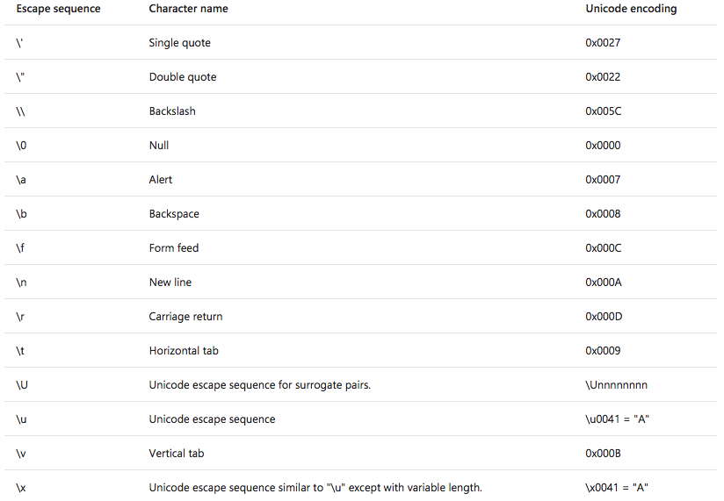
C# String Escape Sequences

Slide 19
C# Strings & LINQ
Because the String type implements IEnumerable<T>, you can use the extension methods defined in the Enumerable class on strings. To avoid visual clutter, these methods are excluded from IntelliSense for the String type, but they are available nevertheless. You can also use LINQ query expressions on strings.

Slide 20
Example: C# Arrays
See OOPC-Chapter2 (Strings.cs) at https://github.com/DotNetTraining/DotNetEssentials/tree/master/Code/OOPC/OOPC-Chapter2

Slide 21
C# Object Oriented Programming
C# provides full support for object-oriented programming including encapsulation, inheritance, and polymorphism.
Encapsulation means that a group of related properties, methods, and other members are treated as a single unit or object.
Inheritance describes the ability to create new classes based on an existing class.
Polymorphism means that you can have multiple classes that can be used interchangeably, even though each class implements the same properties or methods in different ways.

Slide 22
C# Classes and Objects
The terms class and object are sometimes used interchangeably, but in fact, classes describe the type of objects, while objects are usable instances of classes.
So, the act of creating an object is called instantiation.
Using the blueprint analogy, a class is a blueprint, and an object is a building made from that blueprint.
Each class can have different class members that include properties that describe class data, methods that define class behavior, and events that provide communication between different classes and objects.
Fields and properties represent information that an object contains. Fields are like variables because they can be read or set directly.
We will learn more about properties in next chapter.
A method is an action that an object can perform.
A class can have several implementations, or overloads, of the same method that differ in the number of parameters or parameter types. In most cases you declare a method within a class definition. However, C# also supports extension methods that allow you to add methods to an existing class outside the actual definition of the class.

Slide 23
C# Classes
Constructors are class methods that are executed automatically when an object of a given type is created. Constructors usually initialize the data members of the new object. A constructor can run only once when a class is created. Furthermore, the code in the constructor always runs before any other code in a class. However, you can create multiple constructor overloads in the same way as for any other method.
Finalizers are used to destruct instances of classes. In the .NET Framework, the garbage collector automatically manages the allocation and release of memory for the managed objects in your application. However, you may still need finalizers to clean up any unmanaged resources that your application creates. There can be only one finalizers for a class.
Events enable a class or object to notify other classes or objects when something of interest occurs. The class that sends (or raises) the event is called the publisher and the classes that receive (or handle) the event are called subscribers.
To declare an event in a class, use the event keyword.
To raise an event, invoke the event delegate.
To subscribe to an event, use the += operator; to unsubscribe from an event, use the -= operator.
We will learn about events in the next chapter.

Slide 24
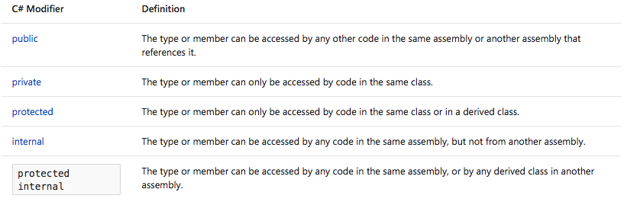
C# Classes
A class defined within another class is called nested. By default, the nested class is private.
To create an instance of the nested class, use the name of the container class followed by the dot and then followed by the name of the nested class.
All classes and class members can specify what access level they provide to other classes by using access modifiers. The following access modifiers are available:

Slide 25
C# Classes
Static Classes and Members: A static member of the class is a property, procedure, or field that is shared by all instances of a class. To access the static member, use the name of the class without creating an object of this class.
Static classes in C# have static members only and cannot be instantiated. Static members also cannot access non-static properties, fields or methods.

Slide 26
Example: C# Classes
See OOPC-Chapter2 (Classes.cs) at https://github.com/DotNetTraining/DotNetEssentials/tree/master/Code/OOPC/OOPC-Chapter2

Slide 27
C# Inheritance
Inheritance enables you to create new classes that reuse, extend, and modify the behavior that is defined in other classes.
The class whose members are inherited is called the base class, and the class that inherits those members is called the derived class.
A derived class can have only one direct base class. However, inheritance is transitive. If ClassC is derived from ClassB, and ClassB is derived from ClassA, ClassC inherits the members declared in ClassB and ClassA.
Structs do not support inheritance, but they can implement interfaces.
Conceptually, a derived class is a specialization of the base class.
For example, if you have a base class Animal, you might have one derived class that is named Mammal and another derived class that is named Reptile. A Mammal is an Animal, and a Reptile is an Animal, but each derived class represents different specializations of the base class.

Slide 28
C# Inheritance
Abstract and Virtual Methods:
When a base class declares a method as virtual, a derived class can override the method with its own implementation. If a base class declares a member as abstract, that method must be overridden in any non-abstract class that directly inherits from that class. If a derived class is itself abstract, it inherits abstract members without implementing them.
Abstract Base Classes:
You can declare a class as abstract if you want to prevent direct instantiation by using the new keyword. If you do this, the class can be used only if a new class is derived from it. An abstract class can contain one or more method signatures that themselves are declared as abstract. These signatures specify the parameters and return value but have no implementation (method body). An abstract class does not have to contain abstract members; however, if a class does contain an abstract member, the class itself must be declared as abstract. Derived classes that are not abstract themselves must provide the implementation for any abstract methods from an abstract base class.
Preventing Further Derivation:
A class can prevent other classes from inheriting from it, or from any of its members, by declaring itself or the member as sealed.
Derived Class Hiding of Base Class Members:
A derived class can hide base class members by declaring members with the same name and signature. The new modifier can be used to explicitly indicate that the member is not intended to be an override of the base member. The use of new is not required, but a compiler warning will be generated if new is not used.

Slide 29
Example: C# Inheritance
See OOPC-Chapter2 (Inheritance.cs) at https://github.com/DotNetTraining/DotNetEssentials/tree/master/Code/OOPC/OOPC-Chapter2

Slide 30
C# Polymorphism
Polymorphism is a Greek word that means "many-shaped" and it has two distinct aspects:
At run time, objects of a derived class may be treated as objects of a base class in places such as method parameters and collections or arrays. When this occurs, the object's declared type is no longer identical to its run-time type.
Base classes may define and implement virtual methods, and derived classes can override them, which means they provide their own definition and implementation. At run-time, when client code calls the method, the CLR looks up the run-time type of the object, and invokes that override of the virtual method. Thus in your source code you can call a method on a base class, and cause a derived class's version of the method to be executed.

Slide 31
C# Polymorphism: Overview
Virtual Members:
When a derived class inherits from a base class, it gains all the methods, fields, properties and events of the base class. The designer of the derived class can choose whether to
override virtual members in the base class,
inherit the closest base class method without overriding it
define new non-virtual implementation of those members that hide the base class implementations
A derived class can override a base class member only if the base class member is declared as virtual or abstract.
Fields cannot be virtual; only methods, properties, events and indexers can be virtual.
When a derived class overrides a virtual member, that member is called even when an instance of that class is being accessed as an instance of the base class.
Accessing Base Class Virtual Members from Derived Classes:
A derived class that has replaced or overridden a method or property can still access the method or property on the base class using the base keyword.
It is recommended that virtual members use base to call the base class implementation of that member in their own implementation.

Slide 32
Example: C# Polymorphism
See OOPC-Chapter2 (Polymorphism.cs) at https://github.com/DotNetTraining/DotNetEssentials/tree/master/Code/OOPC/OOPC-Chapter2

Slide 33
C# Interfaces
An interface is a contract. When you design an interface, you're saying, "If you want to provide this capability, you must implement these methods, provide these properties and indexers, and support these events." The implementer of the interface agrees to the contract and implements the required elements.
When you specify interfaces, it is easy to get confused about who is responsible for what.
The interface: This is the contract. By convention, interface names begin with a capital I.
The implementing class: This is the class that agrees to the contract described by the interface.
The client class: The client calls methods on the implementing class.
Interfaces Versus Abstract Base Classes: The key difference is that an abstract base class serves as the base class for a family of derived classes, and an interface is meant to be mixed in with other inheritance chains. That is, a class can inherit from only a single parent class, but it can implement multiple interfaces.
Interfaces aren't classes, so they don't have constructors, and you can't have an instance of an interface. However-and this is where it gets a bit confusing-if you have a class that implements the interface, you can create a reference to an object of that class, of the type of the interface.

Slide 34
Example: C# Interfaces
See OOPC-Chapter2 (Interfaces.cs) at https://github.com/DotNetTraining/DotNetEssentials/tree/master/Code/OOPC/OOPC-Chapter2

Slide 35
What are we learning in Next Chapter ?
You will learn about Component Based Programming using C#
We will learn about:
Properties and Attributes in C#
Indexer Properties in C#
Delegates and Events in C#
Nullable Types in C#
Exception Handling
Collections and Iterators in C#

Slide 36
Thank You !

